Slide 1
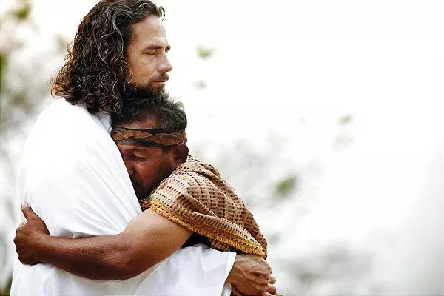
The Value of a Soul
Mark 8:34-38
Pastor Rod M. Lago

Slide 2
Mark 8:34-38 New International Version (NIV)
The Way of the Cross
34 Then he called the crowd to him along with his disciples and said: “Whoever wants to be my disciple must deny themselves and take up their cross and follow me. 35 For whoever wants to save their life[a] will lose it, but whoever loses their life for me and for the gospel will save it.

Slide 3
36 What good is it for someone to gain the whole world, yet forfeit their soul? 37 Or what can anyone give in exchange for their soul? 38 If anyone is ashamed of me and my words in this adulterous and sinful generation, the Son of Man will be ashamed of them when he comes in his Father’s glory with the holy angels.”

Slide 4
I. Your Soul is Eternal

Slide 5
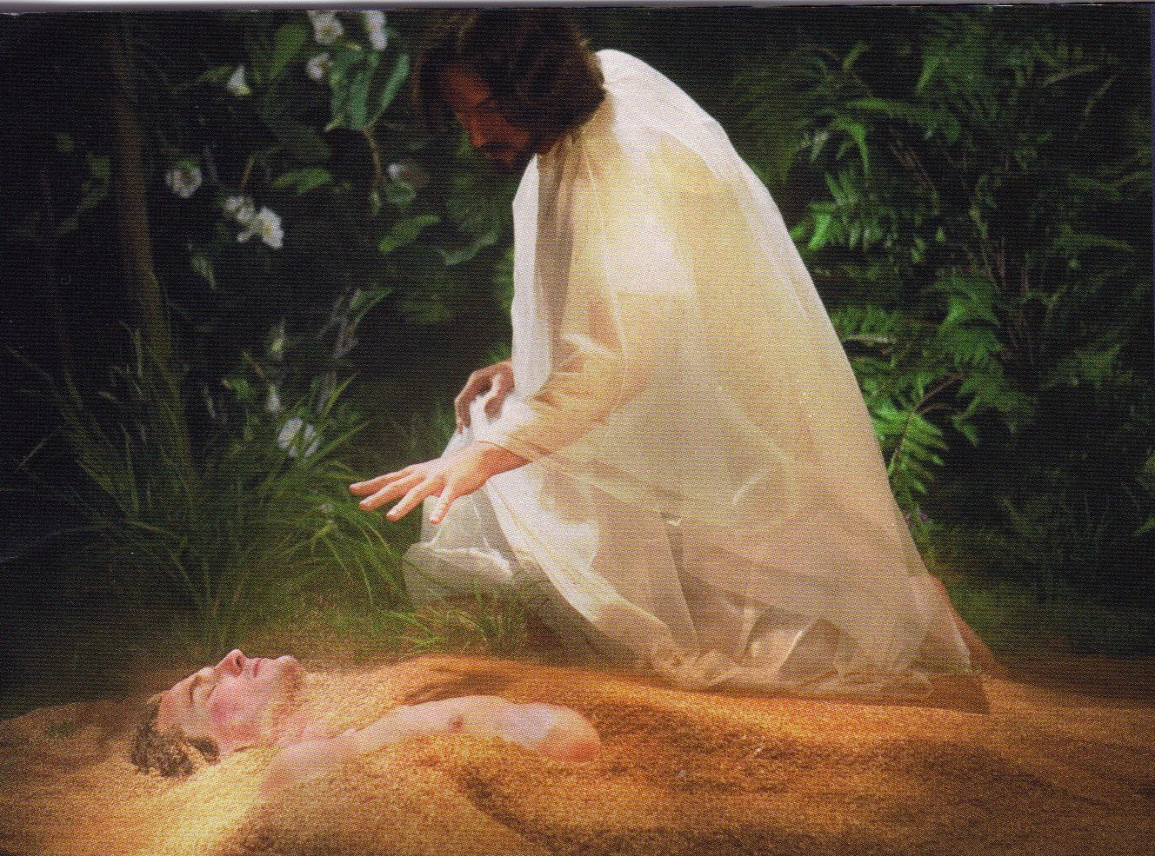
Genesis 2:7 King James Version (KJV)
7 And the Lord God formed man of the dust of the ground, and breathed into his nostrils the breath of life; and man became a living soul.

Slide 6
1 Thessalonians 5:23(NIV)
23 May God himself, the God of peace, sanctify you through and through. May your whole spirit, soul and body be kept blameless at the coming of our Lord Jesus Christ.

Slide 7
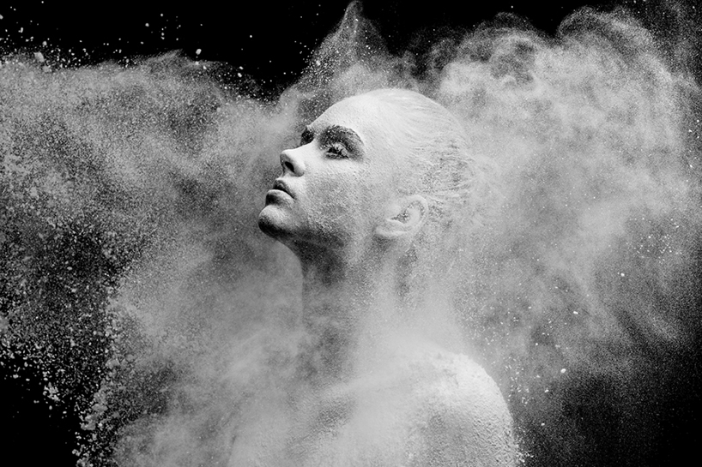
Characteristics of a Soul.
Mind - (Wisdom, knowledge, Understanding)
Will – (Decision Making)
Emotion – (happiness, sadness, Angry, affection, love)

Slide 8
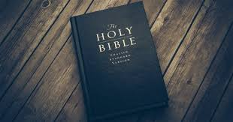
Hebrews 9:27 (NKJV)
27 And as it is appointed for men to die once, but after this the judgment,

Slide 9
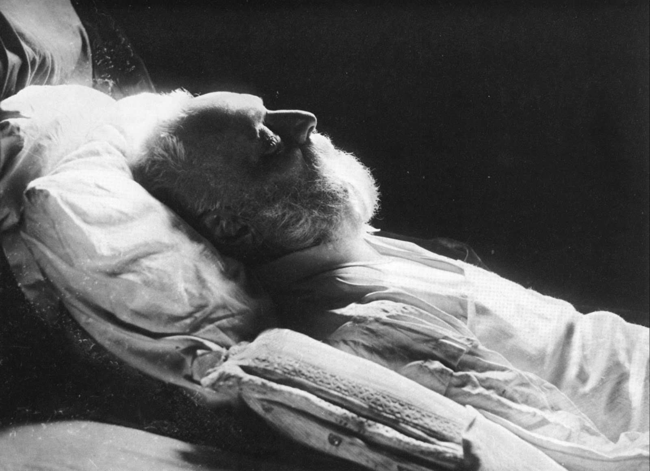
“There is an appointed time and season for everyone to die once, but no one knows when is the time of our death.”

Slide 10
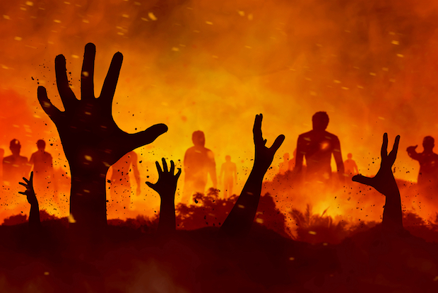
Second Death
Revelation 20:14-15 (NKJV)
14 Then Death and Hades were cast into the lake of fire. This is the second death. 15 And anyone not found written in the Book of Life was cast into the lake of fire.

Slide 11
“Your Eternity does not begin when you die, Your Eternity begin when you say Yes to Jesus today.”

Slide 12
II. Your Soul’s Creativity.

Slide 13

Ephesians 2:10 (NKJV)
10 For we are His workmanship, created in Christ Jesus for good works, which God prepared beforehand that we should walk in them.

Slide 14
Psalm 139:14(NKJV)
14 I will praise You, for I am fearfully and wonderfully made; Marvelous are Your works,
And that my soul knows very well.

Slide 15
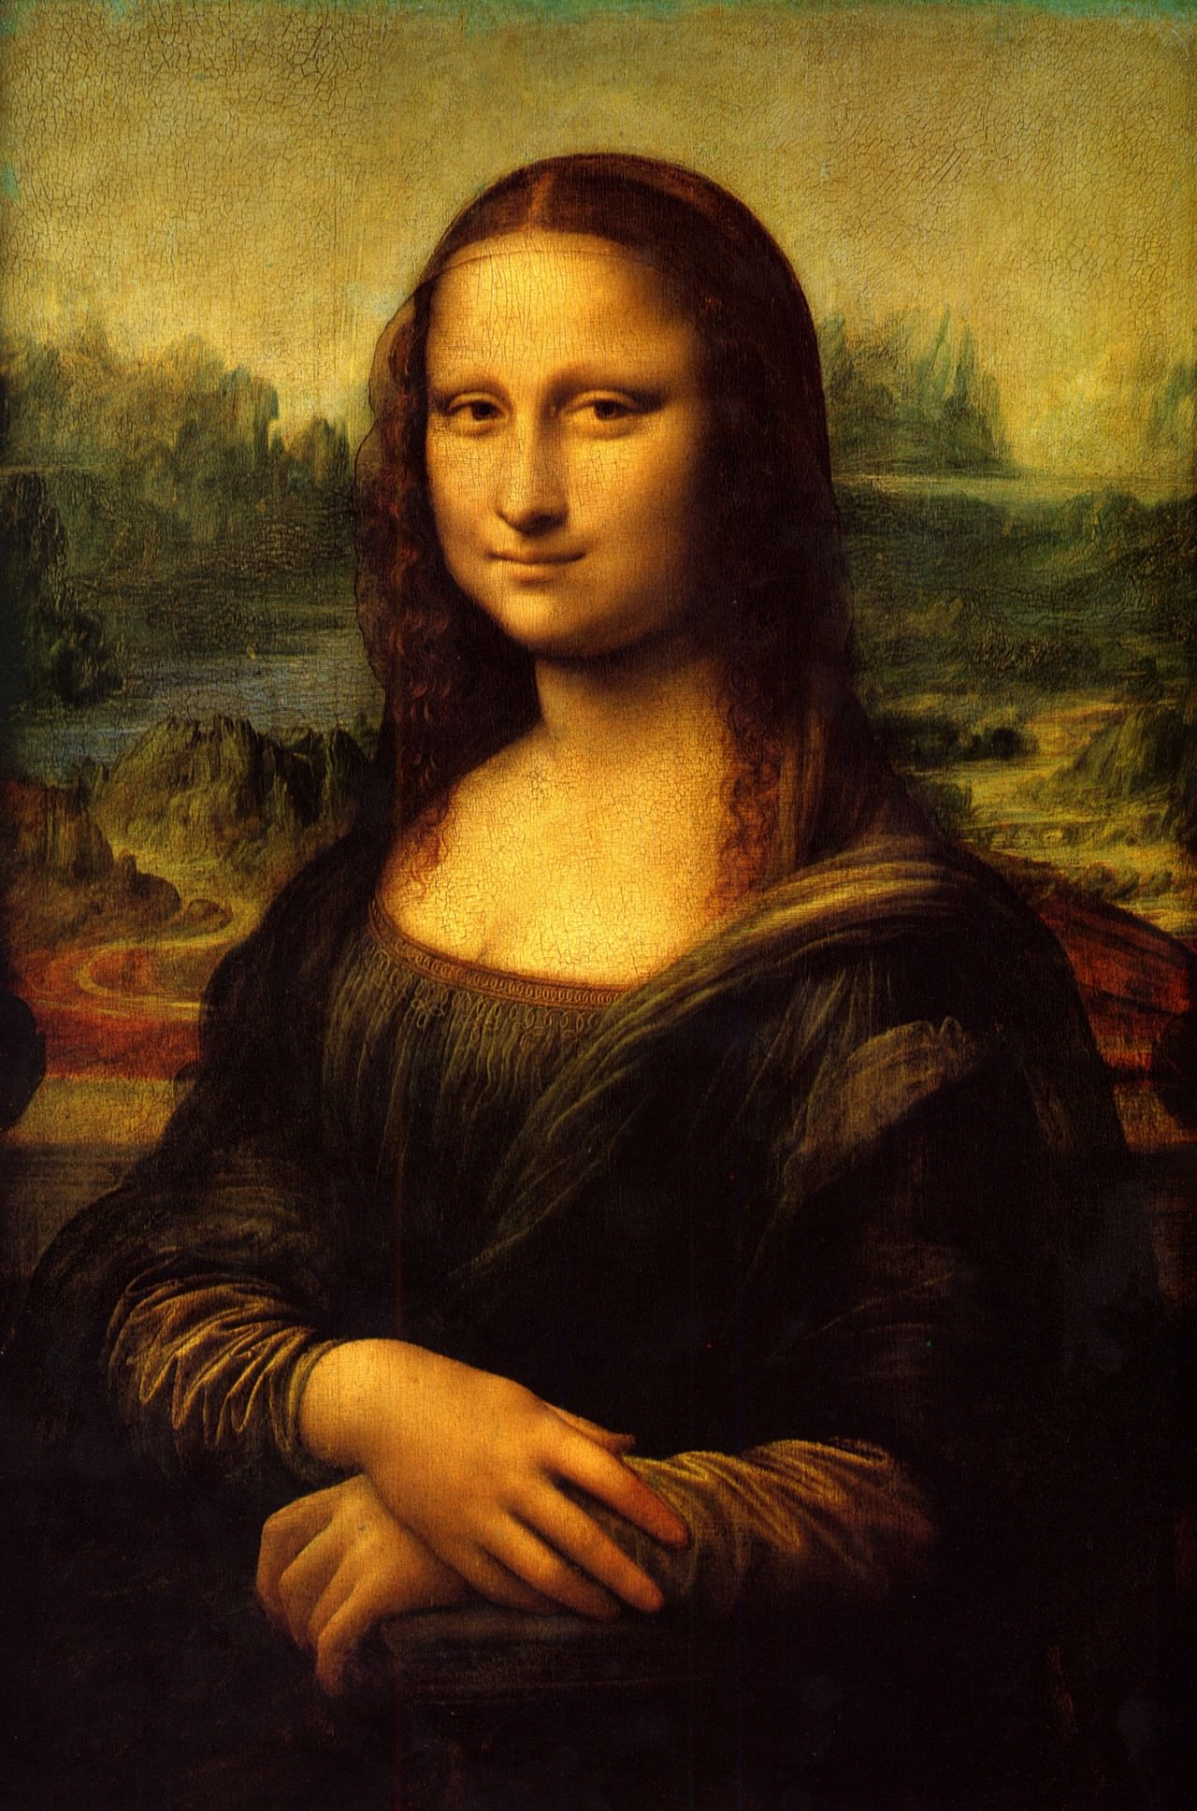

Slide 16
III. Your Soul’s Potentiality.

Slide 17

Ecclesiastes 3:11 (NKJV)
11 He has made everything beautiful in its time. Also He has put eternity in their hearts, except that no one can find out the work that God does from beginning to end.

Slide 18
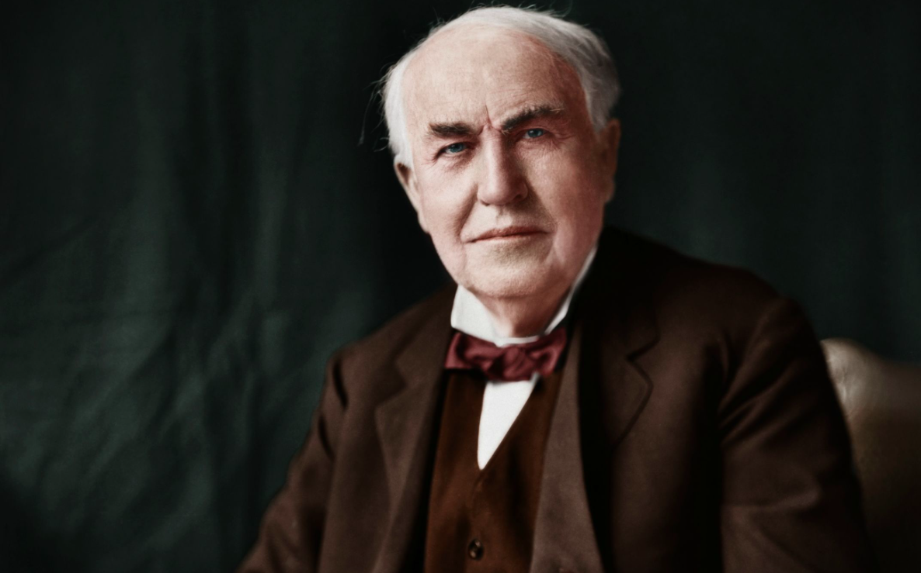
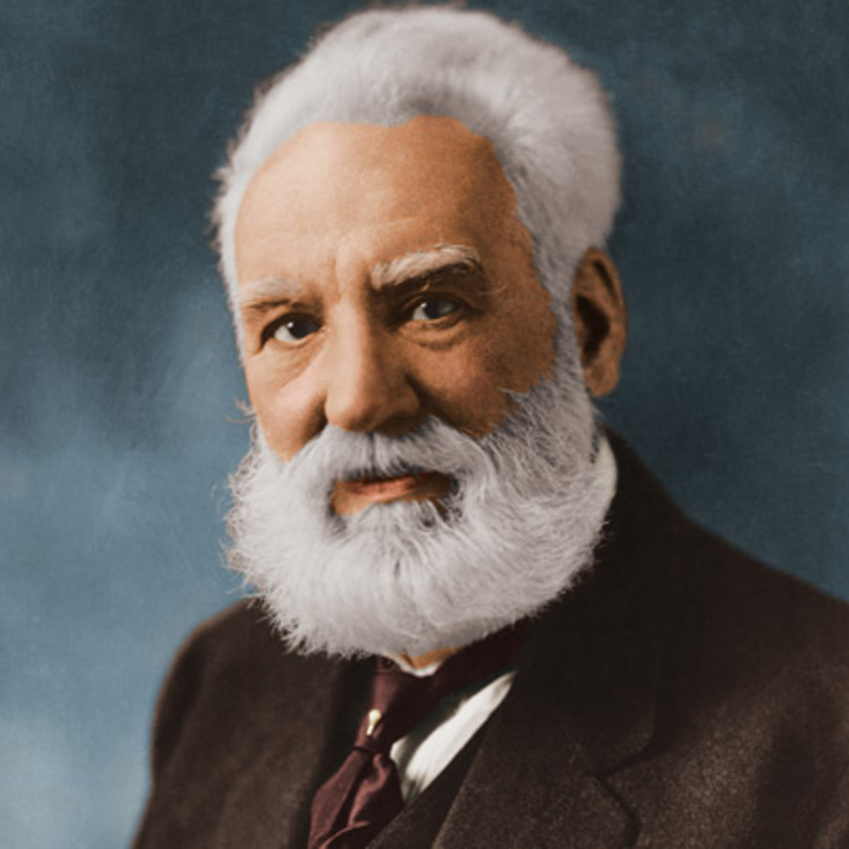

Slide 19
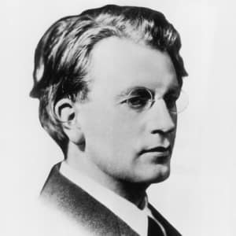
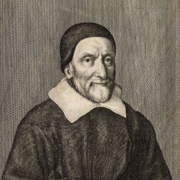

Slide 20
-----------------------
“God Values our Soul because He sees Potentiality in our lives that no riches of this world could ever have.”

